Slide 1

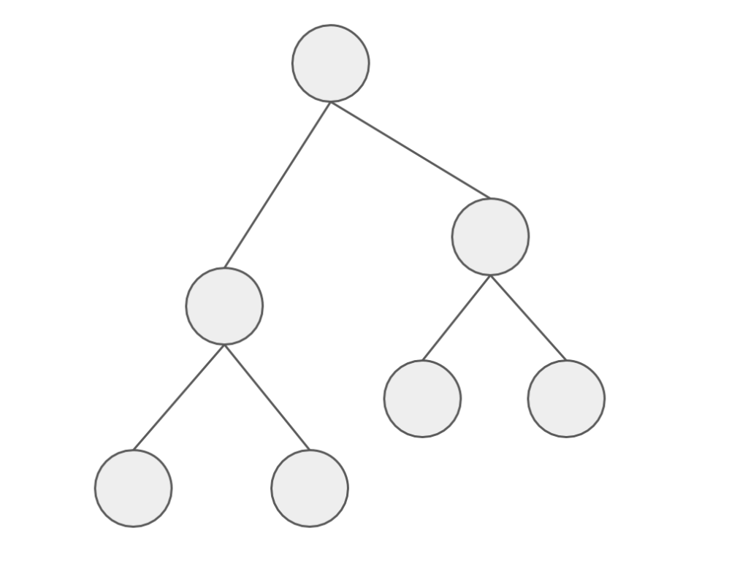
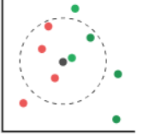
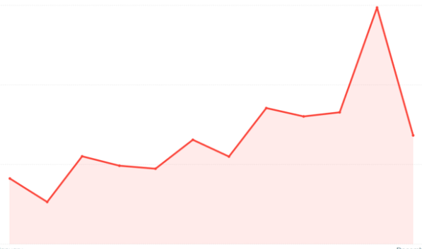
Price Predictor Models
Random Forest
LGBM
KNN
Facebook Prophet
Notes:
To predict prices, we decided to use the Random Forest & LGBM Regressor methods to determine which features are the most important to price an AirBNB.
We then use the KNN Regressor to see how the price is affected with having listings close to your area.
Finally, we used the Facebook Prophet to how prices are affected by time & seasonality to predict Airbnb future prices.

Slide 2
Model Data Cleaning – Adding Columns
amenities
[“Wifi”, “Kitchen”, “Heating”, “Air Conditioning]
amenities_count
4
Notes:
To clean the database, we added the amenities count column to the existing dataset to see if there is a positive correlation between the listing price.

Slide 3
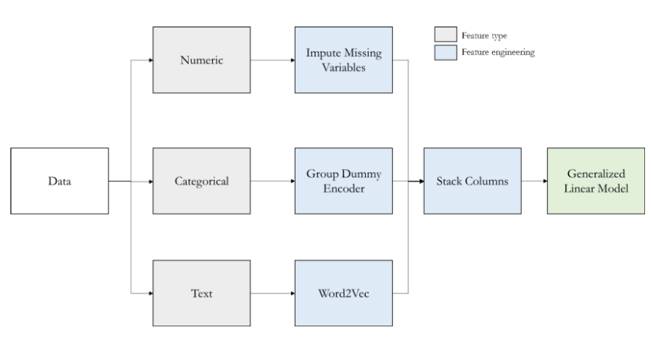
Model Data Transformation Process
Notes:
To predict prices, we decided to use the Random Forest & LGBM Regressor methods to determine which features are the most important to price an AirBNB.
We then use the KNN Regressor to see how the price is affected with having listings close to your area.
Finally, we used the Facebook Prophet to how prices are affected by time & seasonality to predict Airbnb future prices.

Slide 4
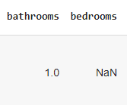


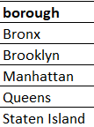
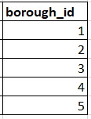

Model Data Transformation Methods
1. Imputing Missing Numerical Data
2. Encoding Categorical Data
3. Vectorizing Text Data
Notes:
To predict prices, we decided to use the Random Forest & LGBM Regressor methods to determine which features are the most important to price an AirBNB.
We then use the KNN Regressor to see how the price is affected with having listings close to your area.
Finally, we used the Facebook Prophet to how prices are affected by time & seasonality to predict Airbnb future prices.

Slide 5
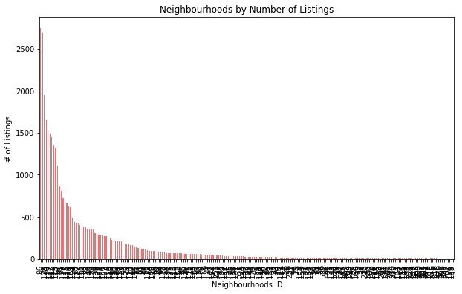
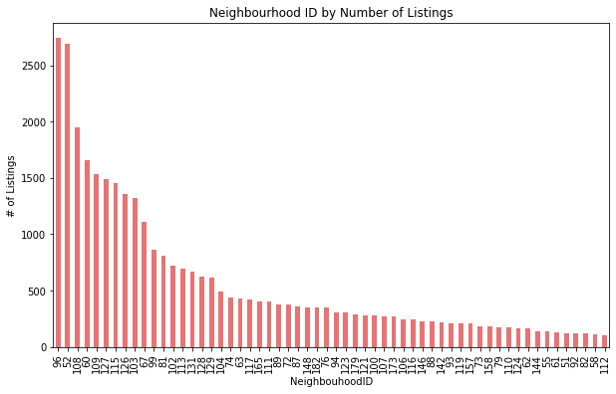
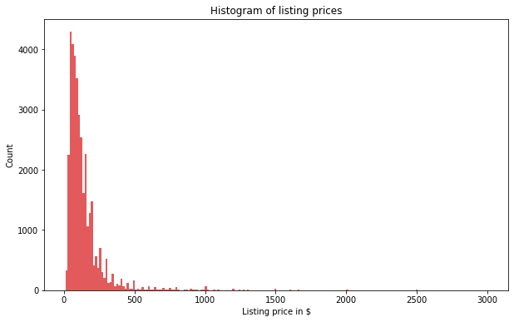
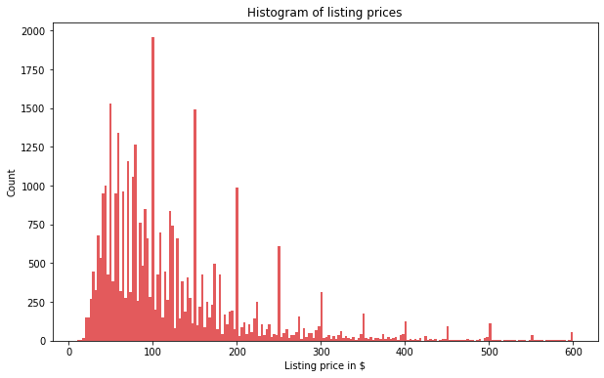
Model Data Transformation Methods
4. Normalizing Data
Neighbourhood Over 100 Listings
Listing Prices Under 600
Notes:
To predict prices, we decided to use the Random Forest & LGBM Regressor methods to determine which features are the most important to price an AirBNB.
We then use the KNN Regressor to see how the price is affected with having listings close to your area.
Finally, we used the Facebook Prophet to how prices are affected by time & seasonality to predict Airbnb future prices.

Slide 6
Model Data Transformation Breakdown
Numerical Data – Impute Missing Values
Categorical Data – Encode
Text Data - Vectorize
Notes:
With existing numeric data, input N/A fields with the average value for that specific column.
Then, for certain data like room type, boroughs, & neighbourhoods, we need to categorize them into numbers.
3) Finally, with text data, we need to vectorize them

Slide 7
Model Data Transformation
Notes:
-To help users explore all listings available in NYC, we created a marker cluster map using Leaflet.
-The clusters display the number of listings with the different boroughs and neighbourhoods in NYC.
-In this example, we selected the the well-known New York borough of Manhattan, and then further zoomed in to the Upper West Side neighbourhood.

Slide 8
Model Challenges
Notes:
-To help users explore all listings available in NYC, we created a marker cluster map using Leaflet.
-The clusters display the number of listings with the different boroughs and neighbourhoods in NYC.
-In this example, we selected the the well-known New York borough of Manhattan, and then further zoomed in to the Upper West Side neighbourhood.

Slide 9
Model Findings – Price Correlation
Notes:
-To help users explore all listings available in NYC, we created a marker cluster map using Leaflet.
-The clusters display the number of listings with the different boroughs and neighbourhoods in NYC.
-In this example, we selected the the well-known New York borough of Manhattan, and then further zoomed in to the Upper West Side neighbourhood.

Slide 10
Model Findings – Features
Notes:
-To help users explore all listings available in NYC, we created a marker cluster map using Leaflet.
-The clusters display the number of listings with the different boroughs and neighbourhoods in NYC.
-In this example, we selected the the well-known New York borough of Manhattan, and then further zoomed in to the Upper West Side neighbourhood.

Slide 11
Model Findings – Nearest Neighbour
Notes:
-To help users explore all listings available in NYC, we created a marker cluster map using Leaflet.
-The clusters display the number of listings with the different boroughs and neighbourhoods in NYC.
-In this example, we selected the the well-known New York borough of Manhattan, and then further zoomed in to the Upper West Side neighbourhood.

Slide 12
Model Findings – Trends & Seasonality
Notes:
-To help users explore all listings available in NYC, we created a marker cluster map using Leaflet.
-The clusters display the number of listings with the different boroughs and neighbourhoods in NYC.
-In this example, we selected the the well-known New York borough of Manhattan, and then further zoomed in to the Upper West Side neighbourhood.

Slide 13
Results
Notes:
-To help users explore all listings available in NYC, we created a marker cluster map using Leaflet.
-The clusters display the number of listings with the different boroughs and neighbourhoods in NYC.
-In this example, we selected the the well-known New York borough of Manhattan, and then further zoomed in to the Upper West Side neighbourhood.

Slide 14
Next Steps…
A major area of concern for cities worldwide is the effect that expansion of Airbnb has made on the housing market for indigenous residents.
Further analysis can help determine if there is a correlation between Airbnb listings and rental/house prices for NYC neighbourhoods.

